Slide 1
Coursework 2016/17 Step 5

Slide 2
Step 5
10 marks for this step!
Builds on all 4 previous steps
Give the user the facility to edit an existing request
If original program well designed should be able to reuse most of the code

Slide 3
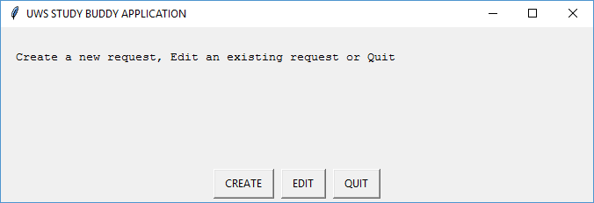
Step 5
Need a new menu option to edit a request
Either CLI (Example)
>>>Welcome to UWS Study Buddy
>>>Enter C to Create, E to Edit or Q to Quit
Or GUI (EasyGUI Example)

Slide 4
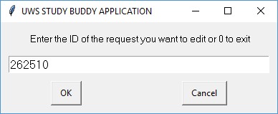
Step 5
User is prompted to enter a valid request ID
Either CLI (Example)
>>>Enter a valid Request ID:
Or GUI (EasyGUI Example)

Slide 5
Step 5
Validation of the user entered Request ID
Is it a six digit integer?
Does it exist in the persistent index of used ID’s (Requests.txt)?
Does the 999999.pck file for this request ID exist on disk?
If no to any of above – generate error message
If yes to all copy the request data from file to memory

Slide 6
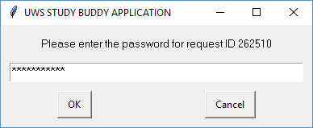
Step 5
User is prompted to enter the password for the request ID he selected
Either CLI (Example)
>>>Enter the password for Request ID 123456:
Or GUI (EasyGUI Example)

Slide 7
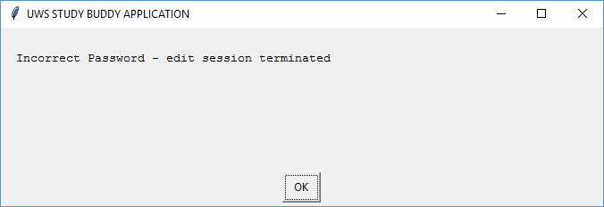
Step 5
Validation of the user entered password
Is it the same as the one in the 999999.pck file
If not you need to decide on a strategy
You might (for example) give three tries
Or you might just say sorry wrong password and return to menu
NO right answer – you decide

Slide 8
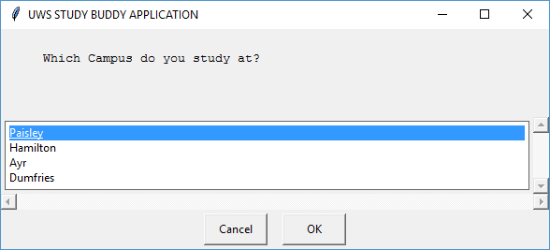
Step 5
Now loop through every attribute in the same order as “Create a Request”
Display the original attribute and prompt the user to update
e.g. CLI example
>>> Campus : Ayr, Enter A to accept or U to Update: U
>>> Enter new Campus Location A (Ayr), D (Dumfries) or P (Paisley) : P
GUI Example (EasyGUI)

Slide 9
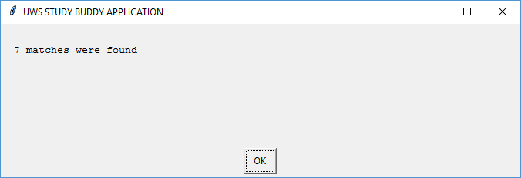
Step 5
After all attributes are updated
Rerun the matching algorithm
And then proceed as step 4 (show matches etc.)

Slide 10
How to preselect with EasyGUI
EasyGUI allows you to choose which option in a choicebox is highlighted as the default option
def get_model(edit):
# If edit = 0, this is a create request
# Else a edit is a string containing the existing value
choices = [“Fiesta", “Focus", “Mondeo", “Kuga"]
if edit == 0:
preselect = 0
else:
preselect = choices.index(edit)
model = choicebox(“Select model ", title, choices, preselect)
return model
N.B. preselect is the 4th argument of a choicebox or multchoicebox
In choicebox preselect MUST pass an integer (position in choices of default value)

Slide 11
How to preselect with EasyGUI
def get_options(edit):
choices = [“Alloys", “Leather", “Bluetooth", “Sunroof"]
if edit == 0:
preselect = 0
else:
preselect = []
for i in edit:
pr = choices.index(i)
preselect.append(pr)
options = multchoicebox("Select ALL of your available options ", title, choices, preselect)
return options
In multchoicebox preselect is a list (of integers) (positions of all selected values)

